Slide 1

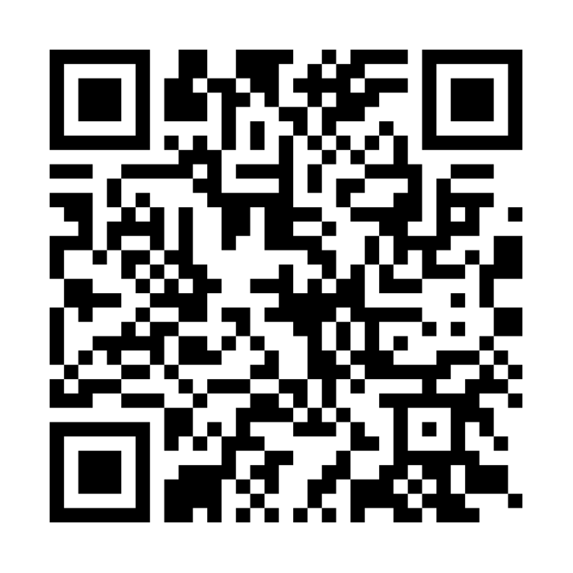

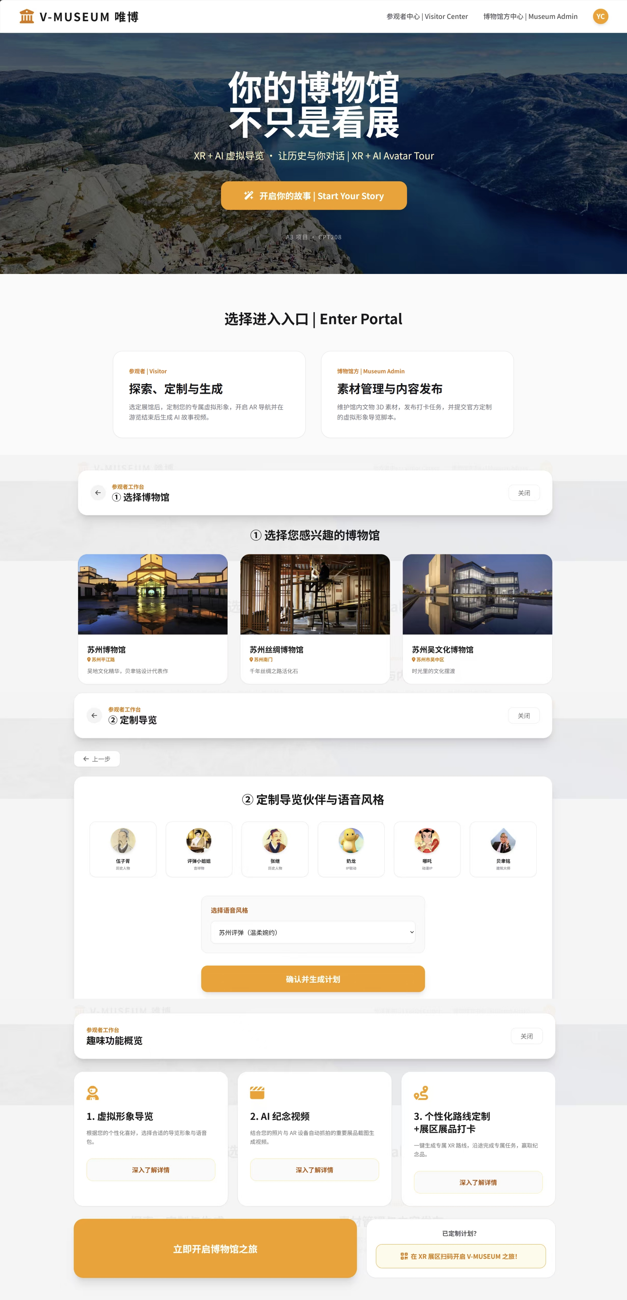
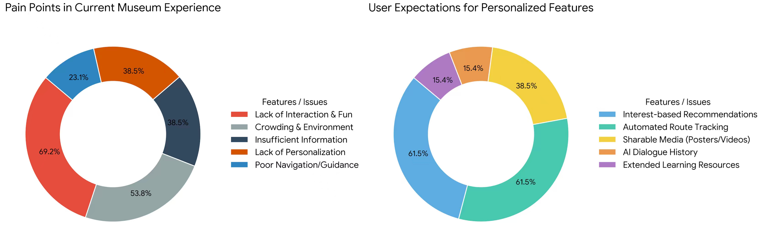
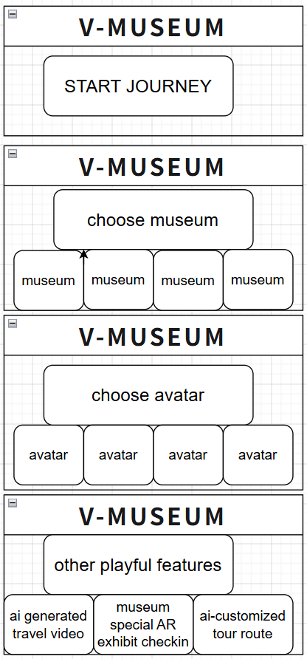
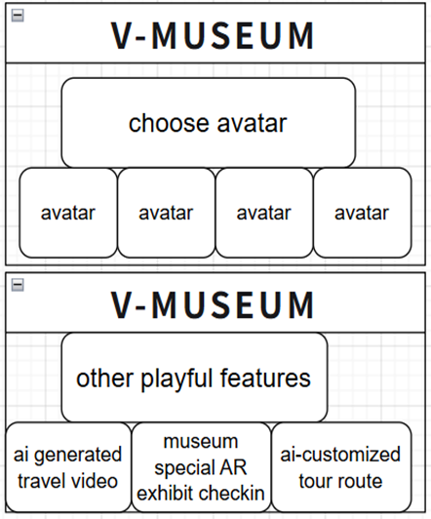



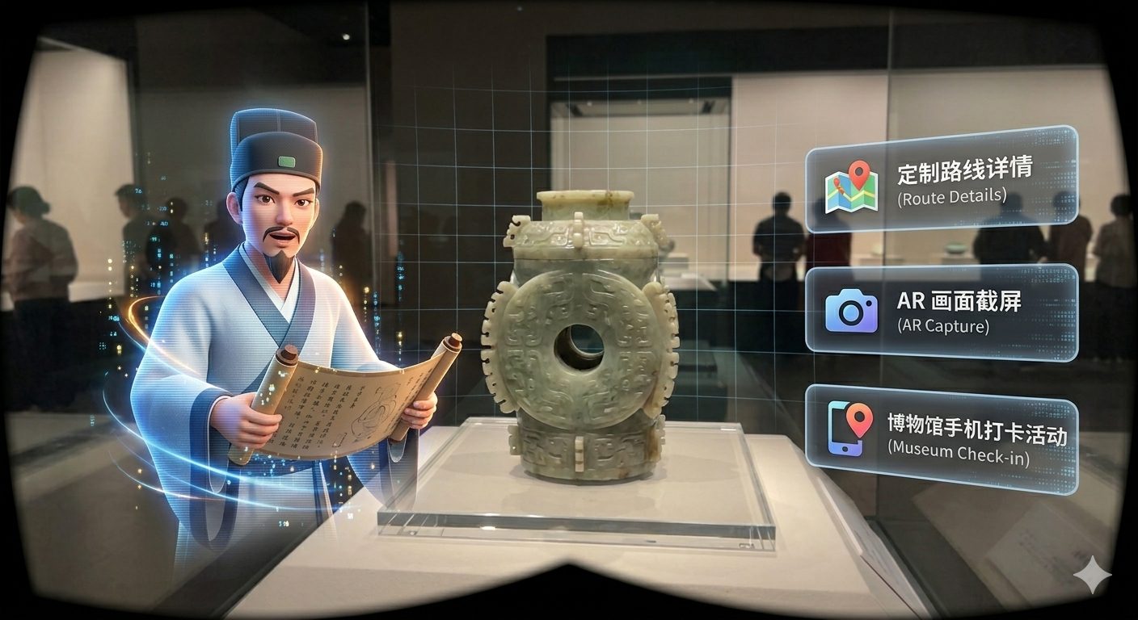
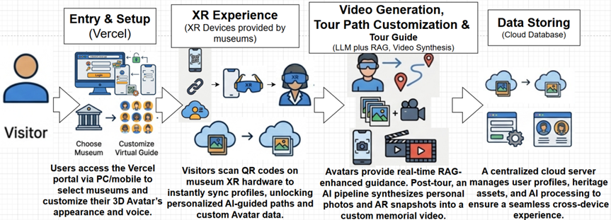
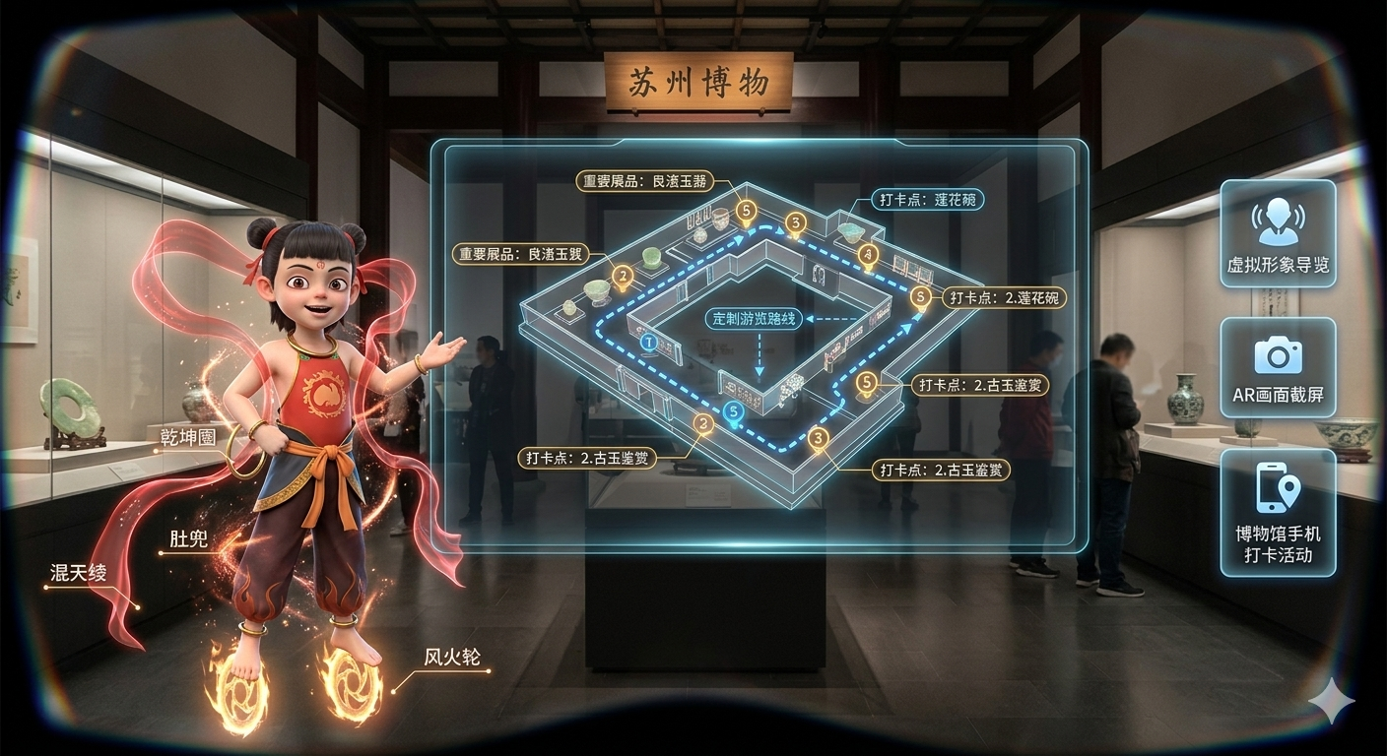
V-Museum: Where History Comes Alive
Through XR & AI-Driven 3D Avatars
From "One-way Display" to "Customized Companionship": An HCD Solution for Enhancing Museum Engagement
CPT208 - Xi’an Jiaotong-Liverpool University, Suzhou, China
Group A3-1: Yixuan Chen (2362456), Yifei Dou (2362307), Ziheng Li (2363040), Yuhan Mei (2362444)
QR code for
V-Museum system:
QR code for
V-Museum Portfolio:
Motivation
Background & Problem
Prototypes & Iteration
In the digital age, museums face the dual challenge of creating deep immersion while avoiding information overload. Current digital tools often fail, leaving visitors disengaged. Research shows effective experiences require active exploration and emotional connection [1], yet many solutions ignore how visitor behavior—like dwell time and personal interest—directly impacts engagement [2].
Design Evolution Process
Our design process was centered on solving the problem of "how to blend storytelling with interaction without making visitors feel overwhelmed or bored." This core idea guided our journey from initial concept to high-fidelity prototype (as in the pictures below).
Evolution of User Experience: From Concept to High-Fidelity
Our goal is to bridge this gap through a human-centered​ approach. We integrate XR to reconstruct authentic historical contexts for emotional impact, with generative AI to enable personalized, conversational narratives. This transforms passive viewing into an active “journey of discovery.” This philosophy aligns with applying HCI to cultural heritage, aiming to enhance understanding and accessibility for diverse learners [1,3]. Ultimately, we seek to make museum visits a memorable, participatory dialogue with history.
Our UI design prioritizes intuitive navigation and accessibility. The Home Page serves as a entry portal, implementing a clear user-role bifurcation that seamlessly directs visitors and museum administrators to their respective functional hubs (as shown in the high-fidelity prototype on the right).
For the visitor experience, the interface offers an unrestricted discovery mode, allowing users to explore and select from a diverse curated list of museums. Once a museum is chosen, the layout transitions into an immersive showcase of our three core playful features. Each feature is designed to maximize engagement through visual hierarchy and minimalist aesthetics, ensuring that the technology (XR & AI) feels approachable and integrated into the cultural journey.
Pain Points of Existing Solutions
1.Rigid Interaction: Most XR is limited to static overlays; visitors remain passive recipients, leading to rapid boredom.
2.Homogenized Content: Fixed scripts fail to cater to diverse ages and knowledge backgrounds.
3.Contextual Fragmentation: Artifacts are isolated from their historical context, missing the "emotional punch" of a lived experience.
User Personas:
Primary User: Xiao Lin (19, Student). Pain point: Views museums as "boring classrooms"; craves RPG-like exploration.
Secondary User: Museum Curator. Pain point: Needs a flexible, low-cost system to keep exhibits engaging for younger audiences.
Research Objectives:
Design Solution
To verify whether the XR+AI museum interactive system can significantly improve visitors’ entertainment, active engagement and satisfaction, and solve the core problems of insufficient fun and weak interactivity in traditional museums.
RO1
To verify whether the solution of customizable virtual 3D avatar guide + generative AI can revitalize cultural relics and history, and break the limitations of one-way display and lack of interaction in traditional and existing XR museum applications.
RO2
Rationale for Design Decisions
During the early stages, we seriously considered two alternative approaches that leaned more heavily on a single technology:
Alternative Option A: Pure XR Historical Recreation
Focused on creating highly immersive, photorealistic recreations of historical environments and events, allowing visitors to "travel back in time.“ It looked amazing, but it was pretty passive. There wasn't much real interaction.
Alternative Option B: Pure AI Voice Chatbot Guide
Developing a knowledgeable, conversational AI voice assistant that visitors could freely question about any exhibit. It could have natural conversations and tailor explanations to each person. That made it more engaging and accessible, but it missed the emotional punch of actually seeing history come to life.
Advantages of the Final Hybrid Option C (XR + AI):
The XR part builds the world and the atmosphere it makes you feel like you're really there in that historical moment. Then the AI voice turns that world into a conversation. Visitors can ask questions on the fly, ask for a simpler explanation, or dive deeper into something they're curious about.
That turns a one-way tour into a kind of discovery game. It's way less boring. Sure, building this hybrid system is more complicated than just picking one approach, but it's worth it. Visitors remember more, get more curious, and have a better time whether they're kids, adults, or just have different ways of learning.
Core Design Concept:
Key Experience Highlights:
Integrate XR historical scene restoration and AI multimodal interaction, combine personalized virtual guide service and immersive experience design, to create an immersive, interactive and customized museum visiting experience, and greatly enhance the fun and engagement of museum visits.
1. XR Personalized Avatar Guidance
1.1 Access virtual guides with 3D avatars at XR sections in museums using XR devices.
1.2 Enable real-time, interactive storytelling with 3D avatars (by LLM in edge devices).
1.3 Receive AI-optimized route guidance and immersive AR narratives at key exhibit locations.
2. AI Co-created Memorial Video
2.1 Visitors can gain memorable moments by taking snapshots using XR devices.
2.2 AI automatically processes and generates tour images using popular trending templates.
2.3 Visitors can generate memorial videos with one-click saving to cloud or social sharing.
3. AI-Powered Personalized Visiting Adaptation
3.1 Visitors can customize their personal touring plan and optimized tour routes using AI before starting the journey.
3.2 Receive real-time, personalized route suggestions delivered by the AI avatar during the museum exploration.
3.3 Integrate voice guidance with museum activities like interactive fragment collection for a fun, unique, and tailored touring experience.
System Flow
Evaluation & Value
Project Value
Practical Value (For Museums)
Offers a high-engagement, low-cost digital transformation template for cultural institutions.
Academic & Design Value (For the HCD Field)
Explores how "personalization" and "multimodal interaction" reduce cognitive load in informal learning environments.
Initial Findings:
Concept testing showed a 65% increase in interaction intent when users could customize their guide's persona. Feedback: "Asking questions 'on the fly' to a persona makes history feel personal."
REFERENCES AND DECLARATION
Academic References:
[1] S. Benford, G. Giannachi, B. Koleva, and T. Rodden, “From interaction to trajectories: Designing coherent journeys through user experiences,” in Proc. SIGCHI Conf. Hum. Factors Comput. Syst., 2009, pp. 709–718.
[2] S. S. Yalowitz and K. Bronnenkant, "Timing and tracking: Unlocking visitor behavior," Visitor Studies, vol. 12, no. 1, pp. 47-64, 2009.
[3] A. Vaswani et al., "Attention is all you need," in Advances in Neural Information Processing Systems, 2017, pp. 6000-6010.
AI Declaration: Framework developed by the team; text polished by ChatGPT-4o; concept illustrations generated by Midjourney.

